Slide 1
MENDELIAN LAWS OF INHERITANCE
Maedel Joy V. Escote, Ph.D.

Slide 2


Slide 3


Slide 4


Slide 5
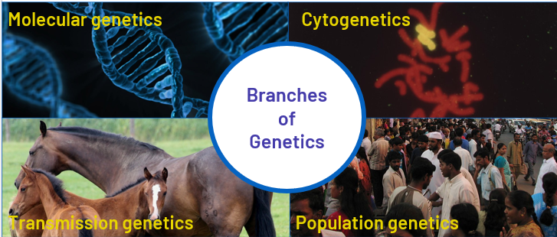

Slide 6
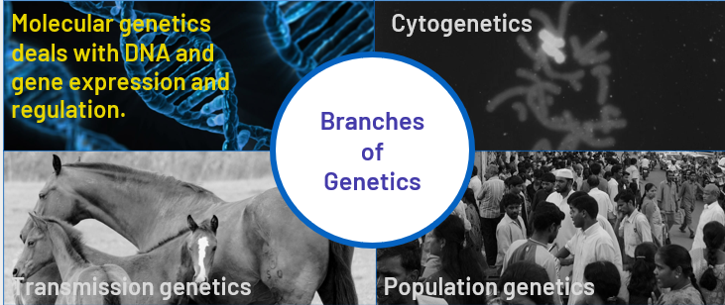

Slide 7
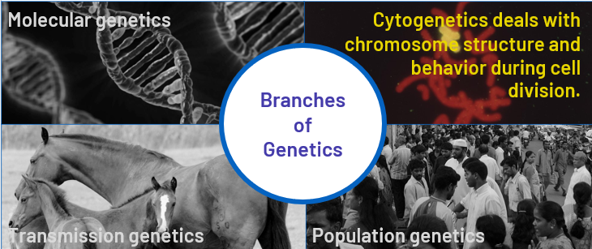

Slide 8
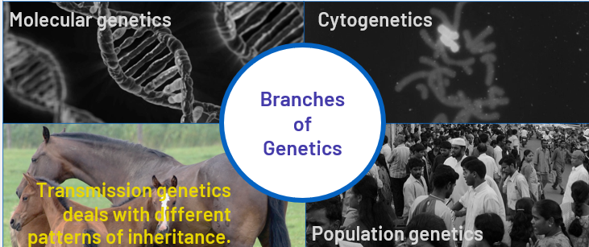

Slide 9
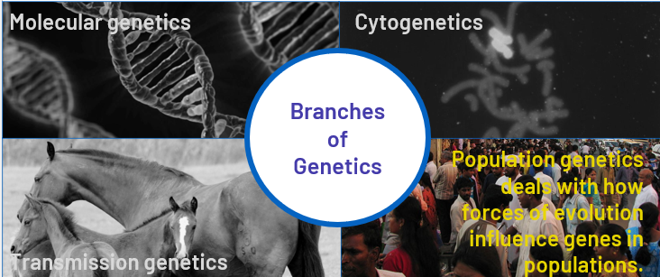

Slide 10
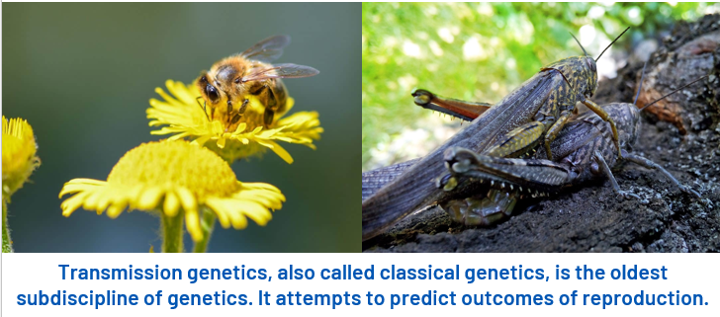

Slide 11
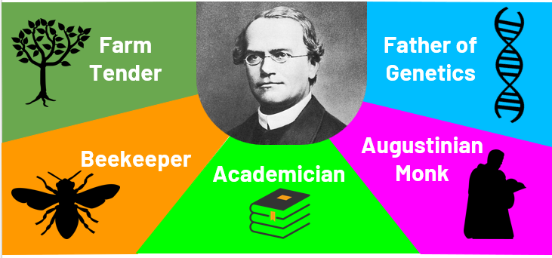

Slide 12
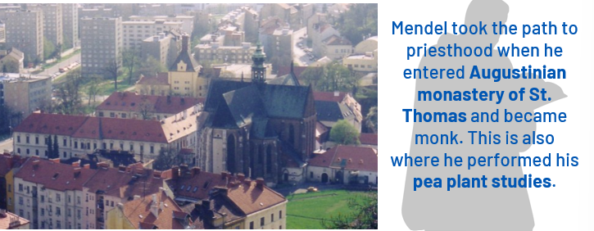

Slide 13
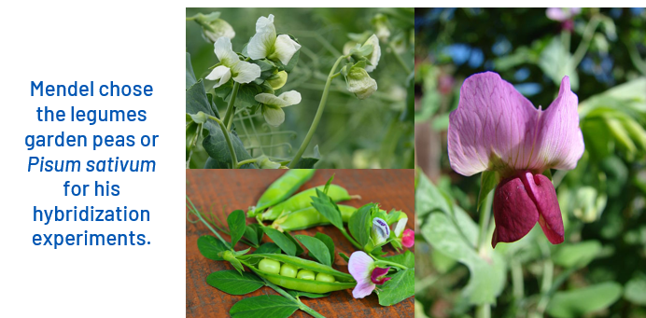

Slide 14
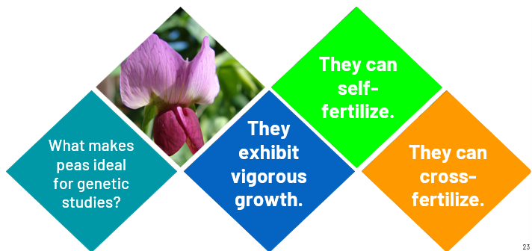
Pea Plant Hybridization

Slide 15
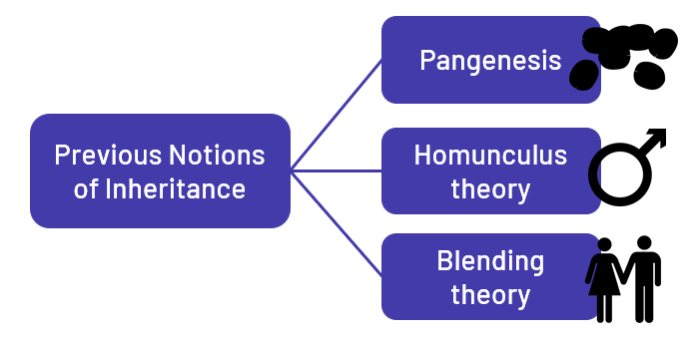
Challenges faced by Mendel

Slide 16
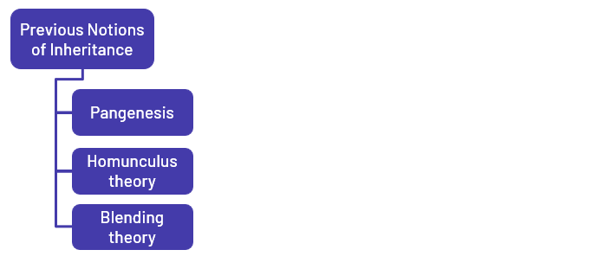
Challenges faced by Mendel

Slide 17
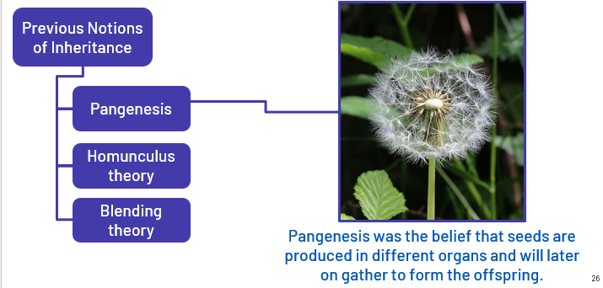
Challenges faced by Mendel

Slide 18
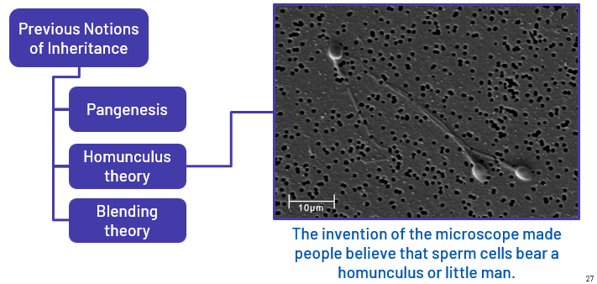
Challenges faced by Mendel

Slide 19
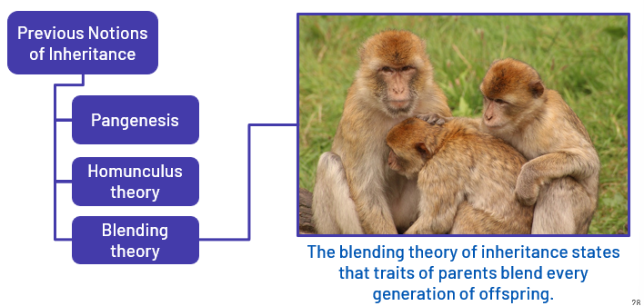
Challenges faced by Mendel

Slide 20
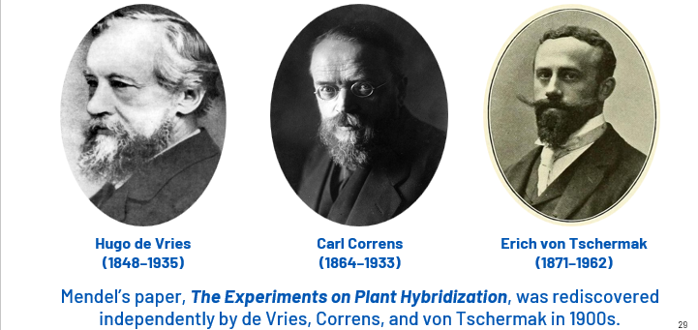
Rediscovery of Mendel’s Work

Slide 21
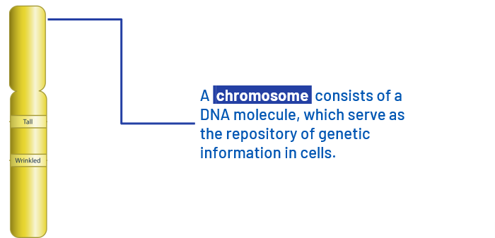
Review of Genetic Terminologies

Slide 22
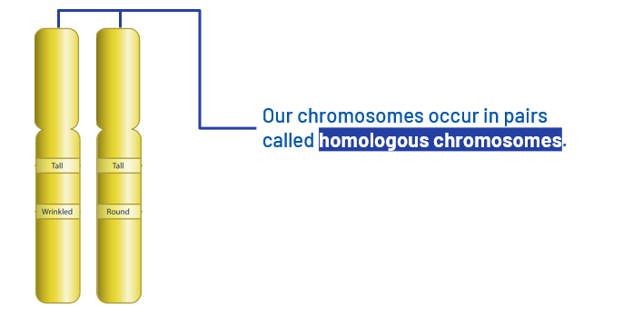
Review of Genetic Terminologies

Slide 23
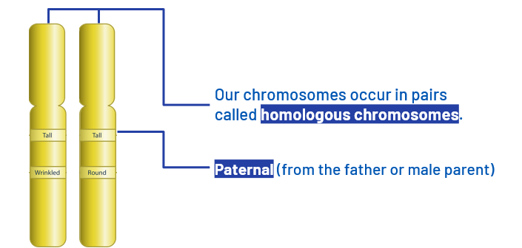
Review of Genetic Terminologies

Slide 24
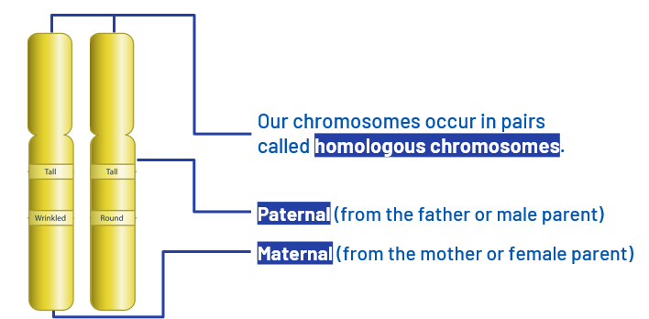
Review of Genetic Terminologies

Slide 25
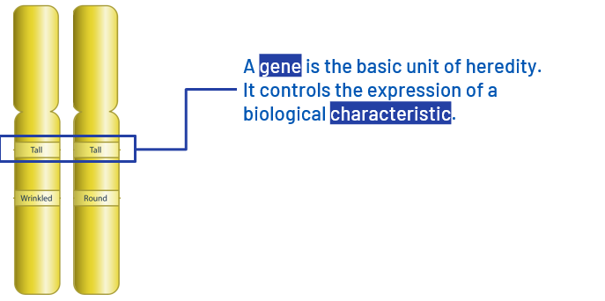
Review of Genetic Terminologies

Slide 26
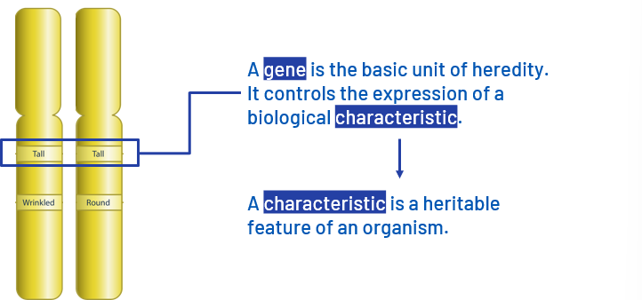
Review of Genetic Terminologies

Slide 27
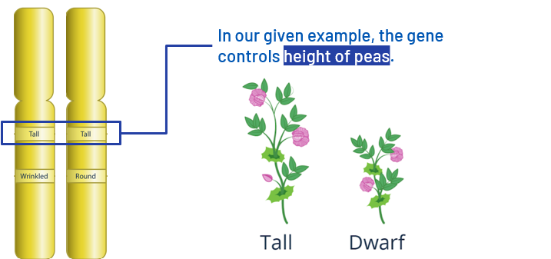
Review of Genetic Terminologies

Slide 28
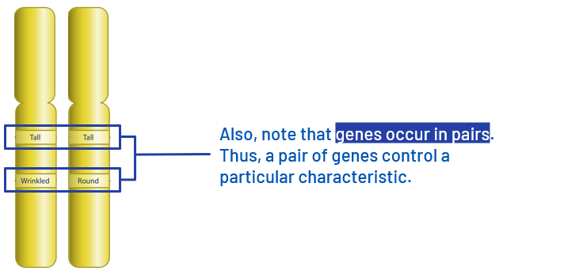
Review of Genetic Terminologies

Slide 29
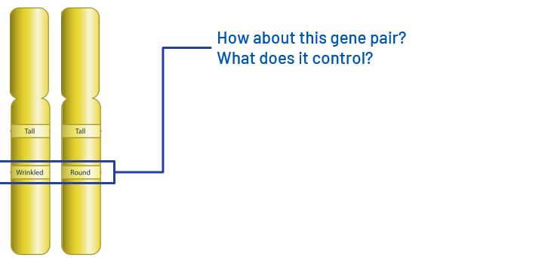
Review of Genetic Terminologies

Slide 30
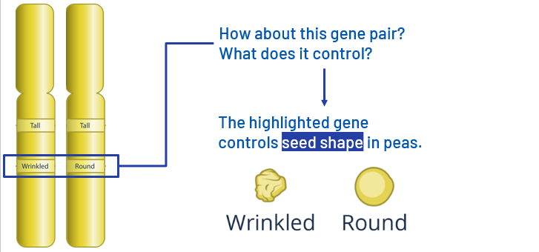
Review of Genetic Terminologies

Slide 31
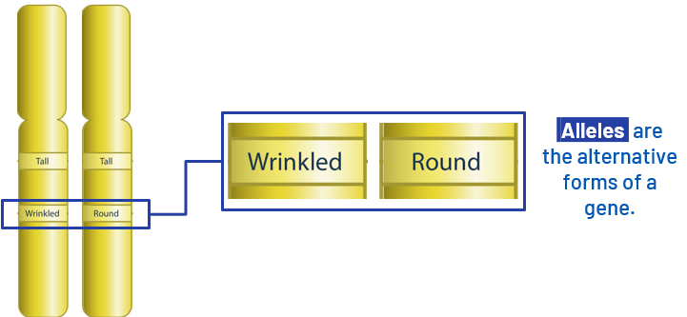
Review of Genetic Terminologies

Slide 32
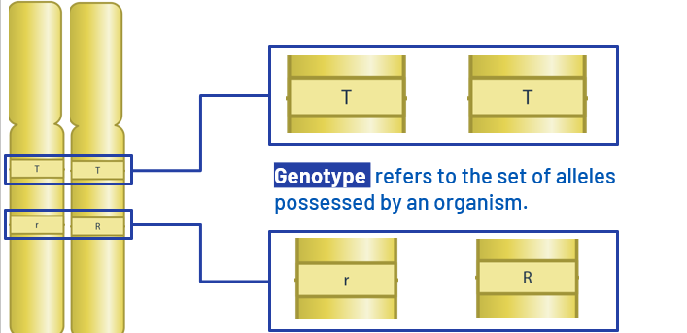
Review of Genetic Terminologies

Slide 33
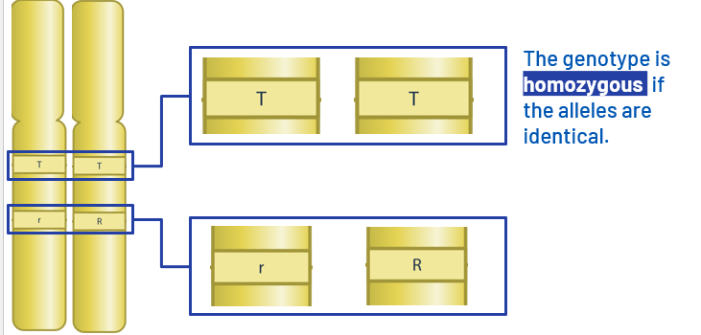
Review of Genetic Terminologies

Slide 34
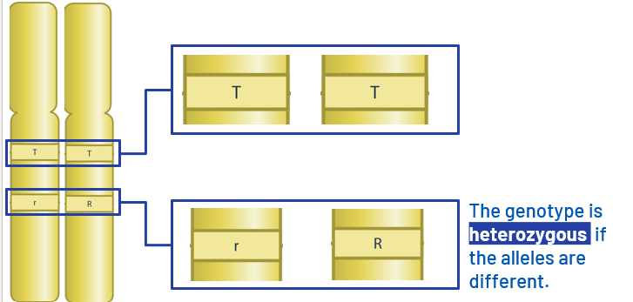
Review of Genetic Terminologies

Slide 35
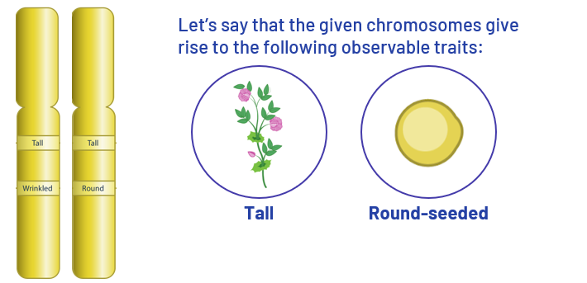
Review of Genetic Terminologies

Slide 36
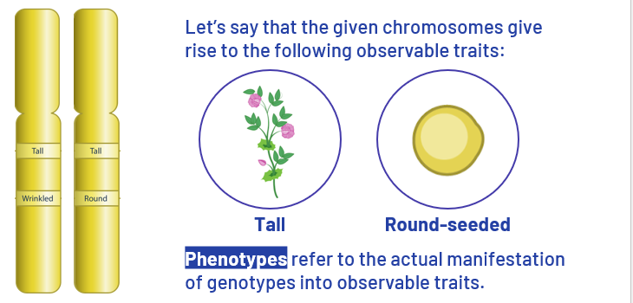
Review of Genetic Terminologies

Slide 37
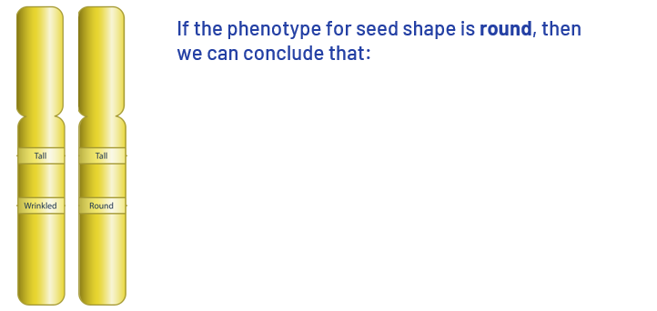
Review of Genetic Terminologies

Slide 38
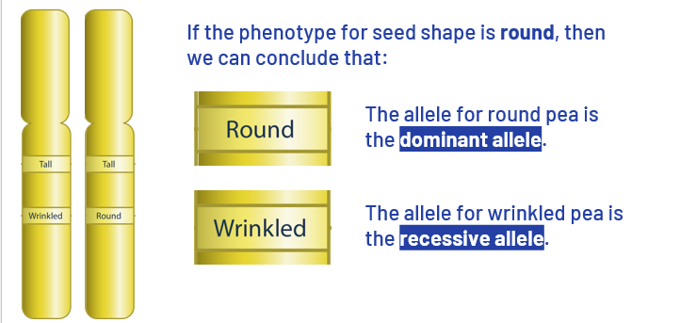
Review of Genetic Terminologies

Slide 39
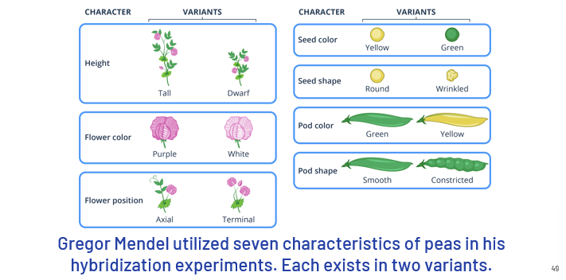
Pea Plant Characters

Slide 40
Monohybrid Cross

Slide 41
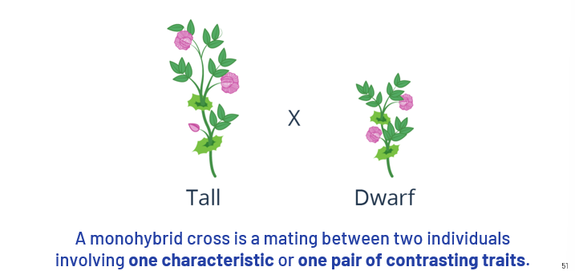

Slide 42
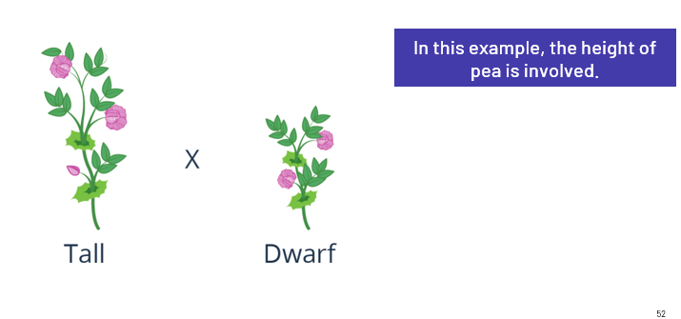

Slide 43
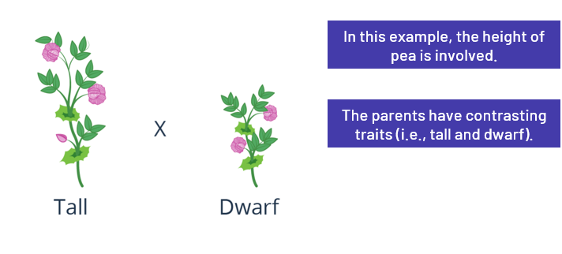

Slide 44
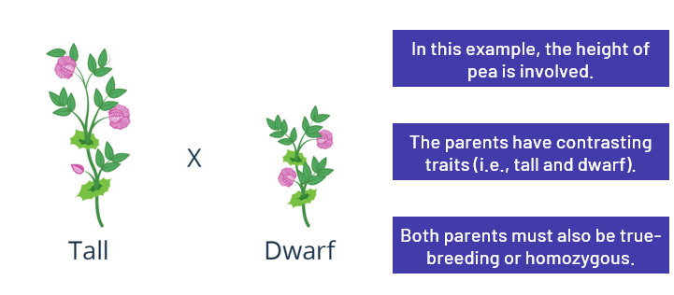

Slide 45
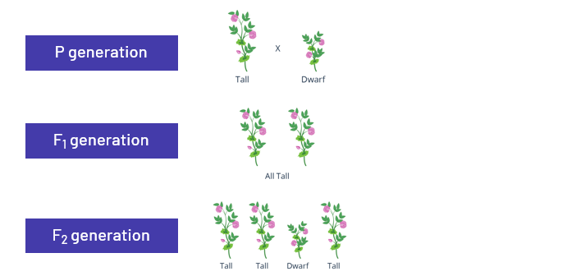

Slide 46
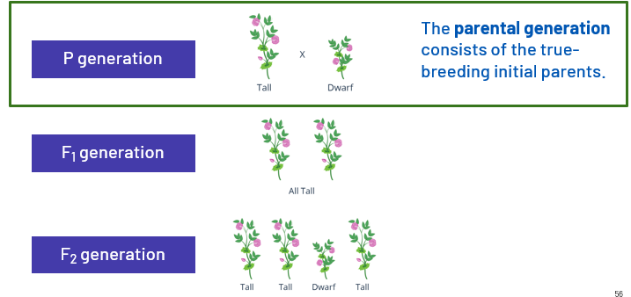

Slide 47
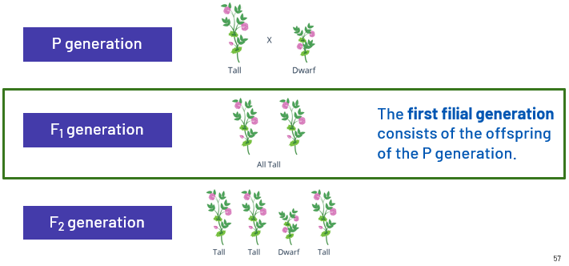

Slide 48
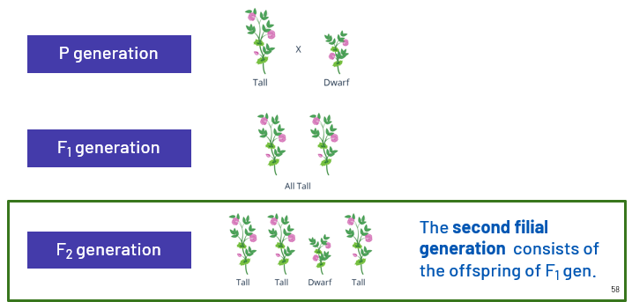

Slide 49
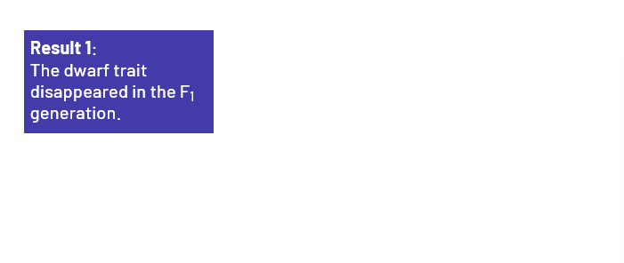

Slide 50
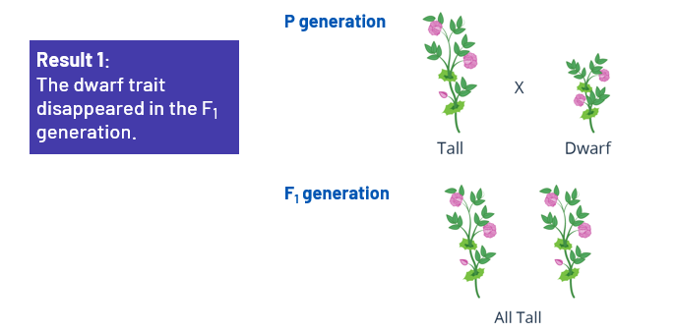

Slide 51
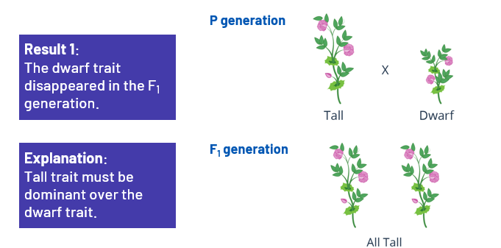

Slide 52
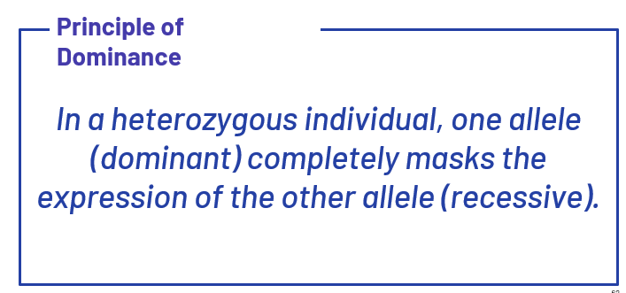

Slide 53


Slide 54


Slide 55
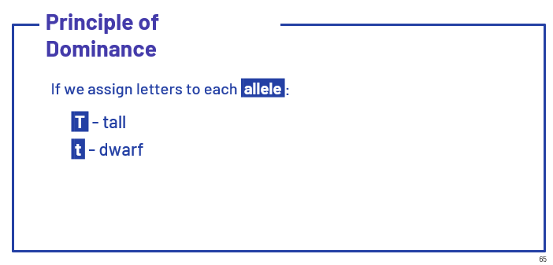

Slide 56
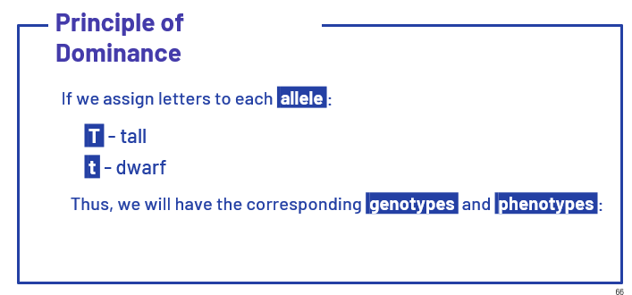

Slide 57
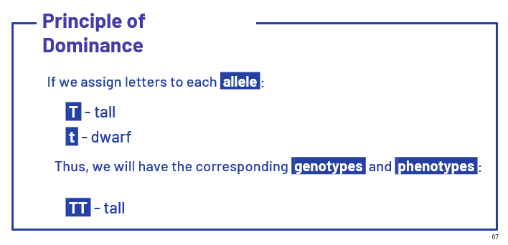

Slide 58


Slide 59


Slide 60


Slide 61


Slide 62


Slide 63


Slide 64


Slide 65


Slide 66

Punnett Square

Slide 67


Slide 68
Dihybrid Cross

Slide 69


Slide 70


Slide 71


Slide 72


Slide 73


Slide 74


Slide 75


Slide 76


Slide 77


Slide 78


Slide 79


Slide 80


Slide 81


Slide 82
Try this…
Brylle is fond of growing crops in his garden. One of the crops that he cultivates is the garden pea (Pisum sativum). One strain of his pea plants is heterozygous for flower colors, with genotype Mm. Another strain of his peas has smooth pods and axial flowers with genotype AaBB. What are the alleles produced by each of these two plants with respect to the indicated characteristics?

Slide 83


Slide 84
Try this…
In pea plants, axial inflorescence is dominant over terminal inflorescence. If Laiza crossed a parent plant that is heterozygous for inflorescence to another plant with terminal inflorescence, what are the genotypic and phenotypic ratios of the offspring?

Slide 85


Slide 86
Try this…
In pea plants, round seeds are dominant over wrinkled seeds, while the tall trait is dominant over the dwarf trait. If you cross two plants that are both heterozygous for seed shape but homozygous dominant for height, what are the expected genotypic and phenotypic ratios of the offspring?

Slide 87


